Slide 1
Prelim 2 Review
With a focus on Sedimentation and Filtration
12 points - 4 multiple choice
27 points – 9 short answer
55 points – design challenges

Slide 2
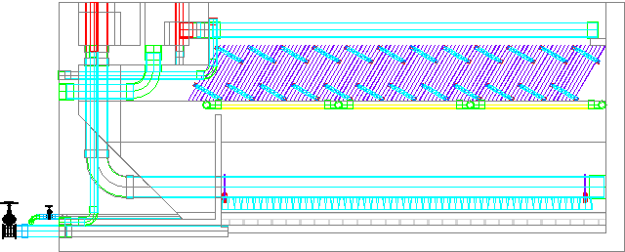
AguaClara Sedimentation Tank
Entrance Channel
Dump poorly flocculated water channel
Exit Channel
Exit Weir that controls water levels all the way back to the next free fall (LFOM!)
Launder
Plate Settlers
Floc Weir
Floc Hopper
Inlet Manifold
Diffusers
Floc Hopper Drain (to remove sludge)
Sed Tank Drain
Notes:
Exercise: Tell the story of the journey of a large floc, a small floc, a rouge loner clay particle, and of a water molecule as each travels through this sedimentation tank.

Slide 3
Sedimentation: How do these velocities connect to design?
Settle capture – determines the slowest terminal velocity floc that will settle to a surface
Slide capture – determines the slowest terminal velocity floc that will slide down the plate. Function of velocity gradient at plate settler surface, angle, and floc density
Upflow – set to obtain good performance of the floc blanket (ongoing research)
Terminal – floc property set by maximum energy dissipation rate of the environment it is in AND by the previous collision potential

Slide 4
Settle Capture Velocity
Which provides better removal of particles, a low settle capture velocity or a high settle capture velocity?
Suppose you keep plate length constant and decrease spacing between plates. What happens to performance and cost?
Could you design a sed tank with a floc blanket without plate settlers?
Notes:
Low capture velocity is best to capture smaller particles
Decreasing spacing would decrease capture velocity and increase cost (more plastic)
no. The plate settlers are needed to return small particles to the floc blanket. All flocs with terminal velocities lower than Vup would be carried into the effluent!

Slide 5
Quiz 11/5/14
Decrease the plate settlers spacing (and maintain the same up flow in the sed tank and the same capture velocity)
same
__crease the amount of plastic needed for plates
__crease the velocity gradient at the plate
__crease the slide capture velocity
__crease the height of the plate settlers
__crease the head loss through the plate settlers
__crease the Reynolds number for flow between the plates
in
in
de
in
de
Notes:
d and f

Slide 6
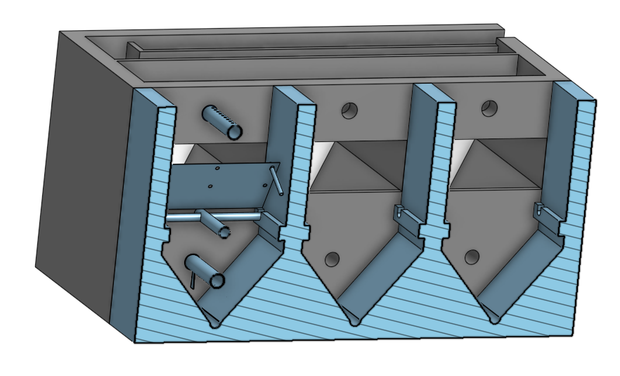
Sed Questions
What determines the depth of the sedimentation tank?
What happens if you make the sedimentation tank 2 m wide or 50 cm wide?
Why does the flow divide evenly between the sed tanks?
Notes:
Add up all the pieces, jet reverser, angled sides, perhaps depth of floc blanket, clear space between floc blanket and plate settlers, plate settlers, effluent manifold.
If you made the sed tank wider the sloped section has to get deeper.
Head loss (primarily in the effluent manifold orifices) forces the water to flow to distribute equally between the parallel paths.
More piezometric head required to drive the water through the parallel paths than there is difference in piezometric head between the paths.

Slide 7
Floc Hopper Q's:
What is in the floc hopper before it fills with flocs?
Why do flocs flow over the floc hopper weir?
Why does a floc blanket interface slowly rise?
How fast are flocs settling unto the sloped bottom?

Slide 8
Floc Blanket
Why are plate settlers necessary for a floc blanket?
What mechanisms could explain how a floc blanket reduces the turbidity of the settled water?
Notes:
Upflow velocity required for a floc blanket results in significant turbidity above the flow blanket

Slide 9
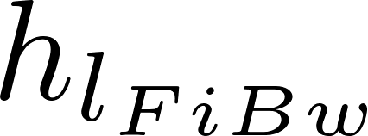
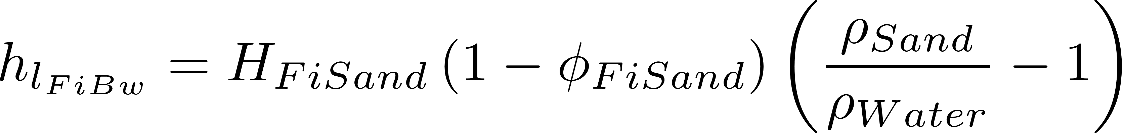

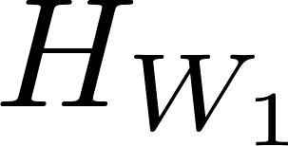

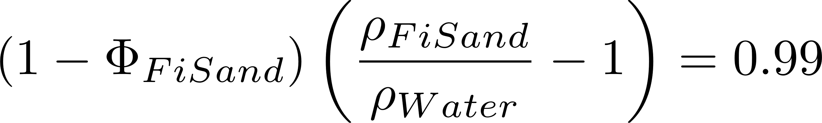
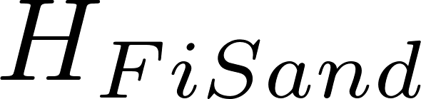
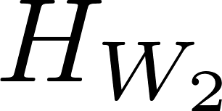
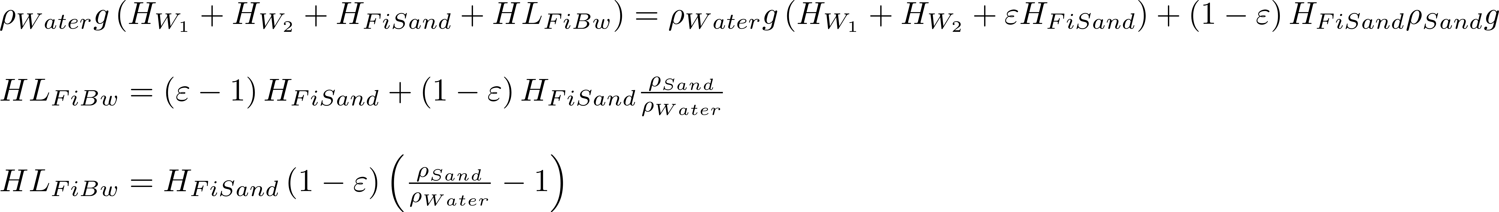
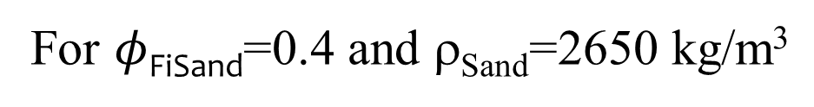
Backwash Requirements – Head Loss (force balance)
Weight of water/Filter area
Weight of sand/Filter area
=
For $φ$_{FiSand}=0.4 and ρ_{Sand}=2650 kg/m³
Notes:
The pressure drop times the filter area is equal to the buoyant weight of the sand grains.

Slide 10
Big picture: Prelim question that didn’t make the cut…
An AguaClara plant that includes all of the latest in design innovations (flocculation, floc blanket, floc hopper, plate settlers, stacked rapid sand filter) is built for a community of 15,000 people with a per capita demand of 3 mL/s per person. The facility has 8 sed tanks and 2 filters. During a drought the flow rate through the plant is reduced by 50%. Which unit processes are affected negatively by a reduction in flow rate and what changes in operation would you advise?
Notes:
Flocculator might drop some flocs. Can clean the flocculator later.
Floc model predicts the flocculator would perform worse
Inlet channel might drop some flocs. Not a problem.
Floc blanket might collapse. Consider taking some sed tanks off line.
Filters will be fine as long as you can divert all of the flow to one filter to backwash it.

